Slide 1
Literature Review on
Reducing Ambiguity in JSON Schema Discovery
By William Spoth, Oliver Kennedy Ying Lu, Beda Hammerschmidt, Zhen Hua Liu
Presented By
Somanshu Gupta, A20499077
Shubham Tiwari, A20499153
Pradeep Thapaliya, A20473870

Slide 2
Agenda
Introduction to JSON Datasets and JSON Schema
Problem in JSON Schema Discovery
JXPLAIN as a Solution to the Schema Discovery
Experiments & Results
Conclusion

Slide 3
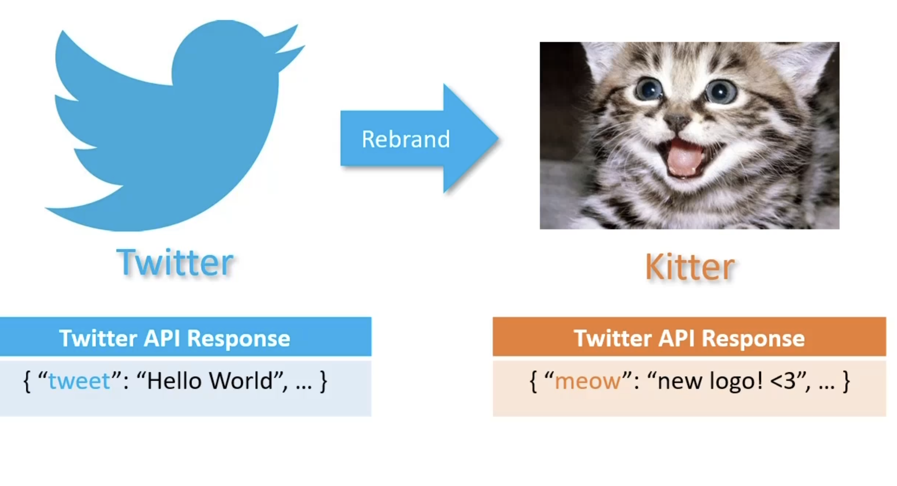
Why JSON Datasets?
Easy Data Provider
Schemeless
Structured
Write Friendly
Example :- Twitter Rebranding
JSON Way :- We don’t need any migration script or schema update, its just changing the string

Slide 4
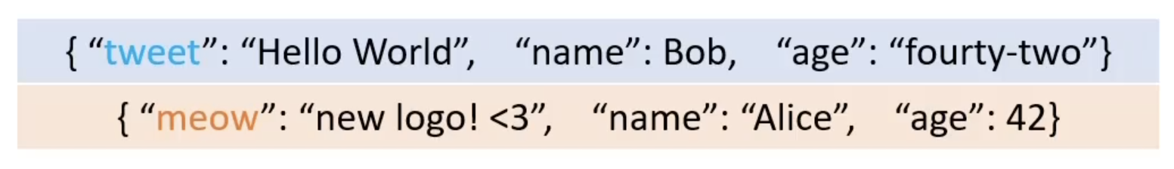
JSON Schema
Schema is self defining.
Every individual row is a schema.
It tells the types and columns it contains and encapsulates large grouping of related fields

Slide 5

Generating JSON Schema
Row 1
U
Row 2
{ tweet:string*,meow:string*, name:string, age:string }
JSON Schema
Note :- meow and tweet were never in the same row
None | Both
meow | tweet

Slide 6
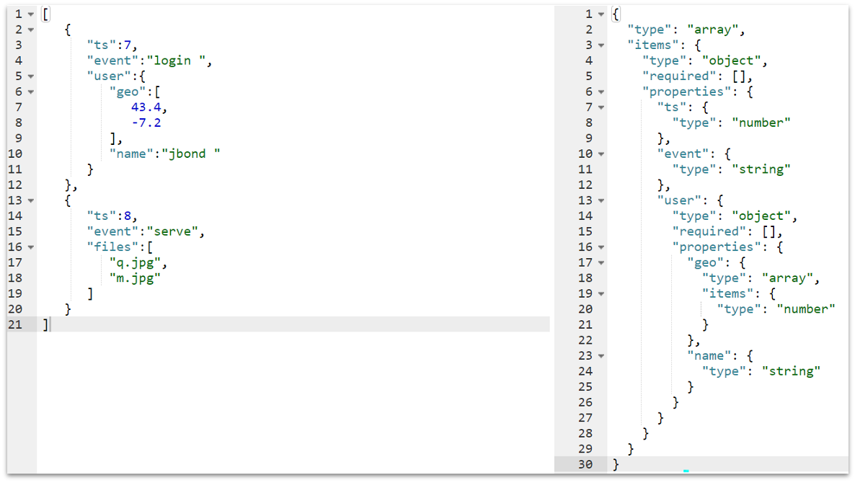
JSON Example
The purpose is to re-create a hidden ground truth schema, which is a description of a set of acceptable JSON data based on a finite sampling of records taken from the set.
JSON Data
JSON Data Generated By Automated Tool

Slide 7
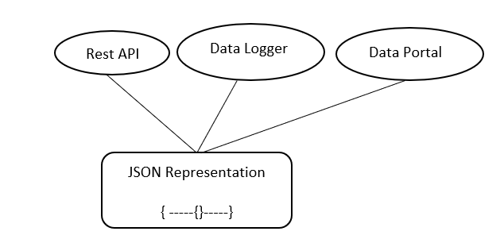
Applications use JSON for data representation
Types of System Approach:
1. Existing Schema Discovery Approach to Resolve Ambiguity.
2. JXPLAIN Assumption about the JSON.

Slide 8
Schema Discovery
1. Existing schema discovery techniques
They decide how to interpret a collection of records by the kind of the records in the collection like:
Arrays are always collection-like
Objects are always tuple-like
And collections always contain a single entity
But, Here it highlights the examples of Json in the wild that, that violate these assumptions, leading to imprecise schemas

Slide 9
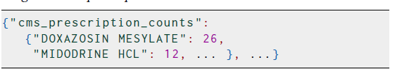

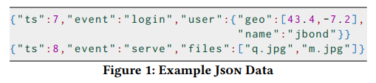

2. JXPLAIN assumption about JSON
In the JXPLAIN it interpret a collection of records by the following.
Arrays as Tuple-Like Structure.
Objects as collections
Multi-Entity Collections
object as collection
Rules to find Type
JSON Data
Naive Discovery
Notes:
modifinf the slides
after 8 slide

Slide 10
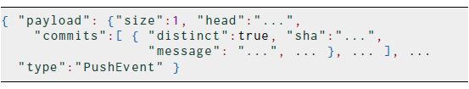

Examples
Array as tuple
object as collection
Multi entity collection

Slide 11
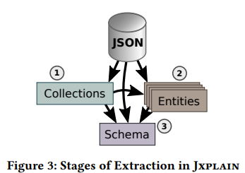
JXPLAIN - A System
It is a general framework for implementing ambiguous-aware schema discovery.
1. Parallelization - it decouples heuristics into separate computation stage
Pass ① invokes the is_collection heuristic to determine the set of paths at which a collection is present.
Pass ② adapts the partition heuristics to precompute a strategy for partitioning entities.
Pass ③ to synthesize the schema.
2. Sampling - it runs the discovery in only small set of training dataset and validates with respect to the test dataset. Following steps are the high level description of sampling steps
Derive a schema from a small sample of the training data
Validate the remainder of the training data
Add samples failing validation to the sample and repeat

Slide 12
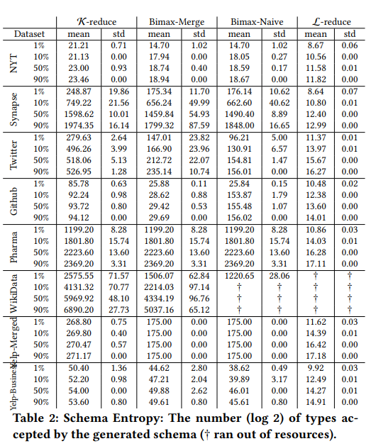
Ambiguity Matrices
Recall
Recall quantifies the number of positive class predictions made out of all positive examples in the dataset.
Entity Grouping
Number of entities output within a schema (partitioned)
Schema Entropy
Schema entropy is computed by treating each optional path as a binary decision, taking into account mandatory and locally mandatory paths

Slide 13
Ambiguous Schema Extraction
Interpreting collection of records by the kind of records in the collection are decided by schema discovery techniques. Collections always contain a single entity.
Collection Type: - Array
Tuple Type: - Objects
Multi collection entity

Slide 14
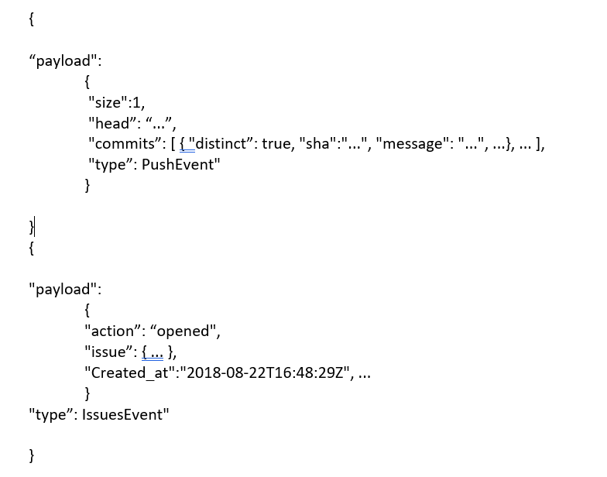
Arrays:
Example geo field encoded as an array, as fields coordinates are 2-element tuple and not a collection of numbers
{
“ts”: 7,
“event”: “login”,
“user”: {“geo”: [43.4, -7.2], “name”: “jbond”}
}
2. Objects as collection:
Maps keys (drugs) to values (prescription counts), field is a nested collection. Example: - {“cms_prescription_counts": {"DOXAZOSIN MESYLATE": 26, "MIDODRINE HCL": 12, ...}, ...}
3. Multi Entity Collection
Log data and event-based web APIs are often composite streams of multiple data types.
EXAMPLES

Slide 15
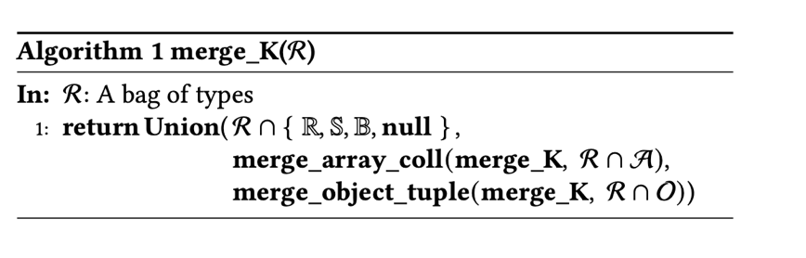
Algorithms
K-reduction:-
Array kinded types are interpreted as single-entity collections and object kinded types are always interpreted as tuples.
It is implemented through helper functions and have parameter recursive merge heuristic, k-reduction.
K-reduction distributivity: - merge_K (R1 U R2) = merge_K(merge_K(R1) U merge_K(R2)).
{
“ts”: 7,
“event”: “login”,
“user”: {“geo”: [43.4, -7.2], “name”: “jbond”}
}
Array Type
{“cms_prescription_counts": {"DOXAZOSIN MESYLATE": 26, "MIDODRINE HCL": 12, ...}, ...}
Object Type

Slide 16
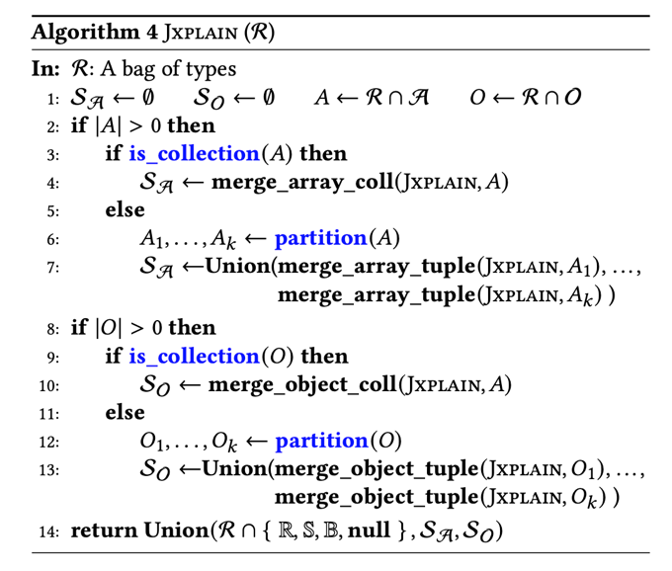
Algorithms
2. JXPLAIN Merge:-
Algorithm makes two decisions: -
Does a bag of array- or object-kinded types encode a collection or a tuple?
Given a bag of tuples, are there multiple entities represented in the bag?
Decisions are encoded in two heuristics functions:
is_collection
partition
Inferences has been made based on the input elements.
Collection Type :- If input elements are collections, nested types are merged to get collection nested type
Tuple Type :- if inputs are tuples, JXPLAIN partitions the bag into individual entities and produces a schema for each individually.

Slide 17
JXPLAIN Helper Heuristics
JXPLAIN relies on two default heuristics:-
is_collection
Objective :- Whole collection of JSON types as input and produces a set of paths that should be interpreted as collections
partition
Objective :- It partition into individual entities and produces a precise schema for each entities individually.

Slide 18
Bimax Algorithm
It works on bi-clustering which derive a distance that measures that accounts for entity size, by reducing the weights of features in large entities.
It helps in entity detection where we need to simultaneously group records by feature occurrence, while also grouping features by co-appearance in records.
Working :-
K_{max} = Largest Key Set
K_{max} (K_{sub} ) , K_{max} (K_{overlap} ), K_{max} (K_{disjoint}) are the partition groups of remaining records
K_{sub} K_{overlap} K_{disjoint}
Note :- With this approach , knowledge of number of entities is not required, It simply puts more similar records close to one another.

Slide 19
Experiments & Claims
JXPLAIN produces schemas that are significantly more precise (i.e., admit fewer types) than K-reduction, while not incorrectly rejecting types that are legitimately part of the schema,
A clustering strategy based on Bimax bi-clustering is preferable to a standard technique like k-means.
The merge step described is critical for creating compact schemas.
The overhead of the additional steps required by Jxplain is not prohibitive.

Slide 20
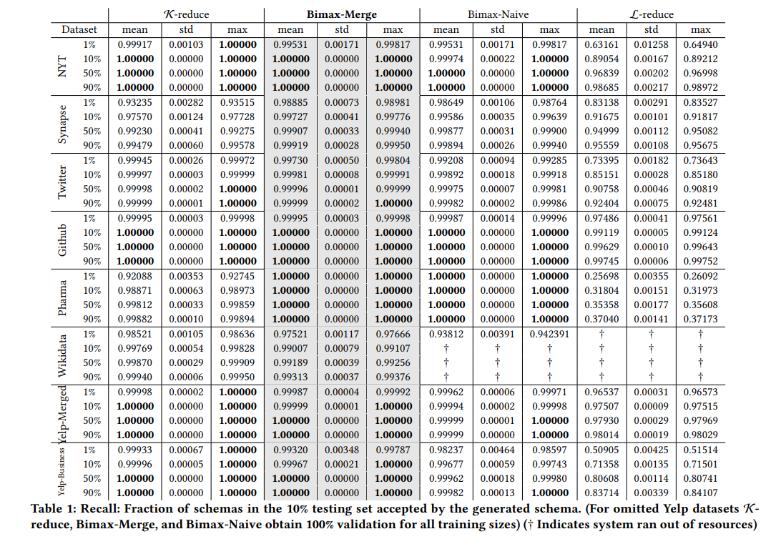
Results
In this paper, the author compared four different algorithms, which are
K - Reduce
Bimax Naive
Bimax Merge
L - Reduce

Slide 21
Critique & Conclusion
Conclusion:
Jxplain avoids two assumptions concerning the creation of Json records:
Which hierarchical structures encode nested collections, and
how many entities exist in a Json object collection (nested or not)
Note :- Jxplain adds many pre-processing rounds to conventional schema discovery to avoid these assumptions. Although these passes add a significant amount of cost to the extraction process, the resultant schemas are tighter and more compact, particularly for complicated Json data models, lowering the amount of human tweaking necessary to optimize them.

